Slide 1
Over-the-Counter Cough Medicine Abuse
Working together to protect teens

Slide 2
Rx and OTC Medicine Abuse
The Office of National Drug Control Policy reports that medicine abuse is our nation’s fastest-growing drug problem.

Slide 3
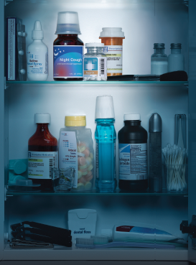
Teens Turn to Medicine Cabinets to Get High
According to the 2013 Monitoring the Future Report, 4 percent of teens have abused OTC cough medicines containing dextromethorphan (DXM) to get high.
Teens mistakenly think this is a “safer” high.
Unfortunately, many parents are not aware of this behavior.
Detecting it is a challenge for parents and educators. Awareness is the key to prevention.

Slide 4
What Is Dextromethorphan?
A safe and effective cough suppressant ingredient found in 100+ OTC cough/cold medicines
The most widely used cough suppressant in the U.S.
Abused by teens taking 25 times or more than the recommended dose to get “high”

Slide 5
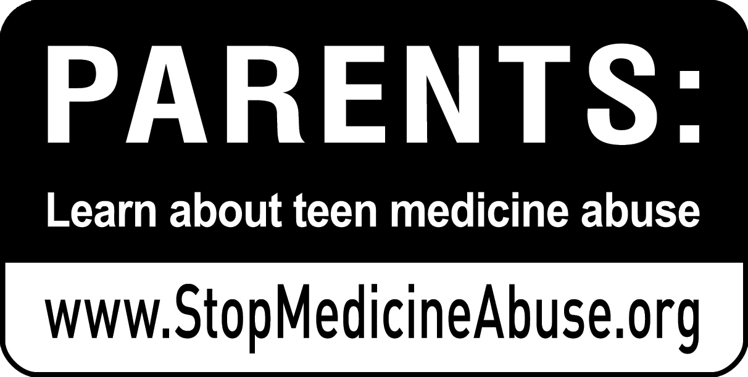
How To Know If a Medicine Contains DXM
Identify products that contain DXM by reading the ingredients list or by looking for this icon on the package.

Slide 6
What Are the Side Effects of Abuse?
Nausea and vomiting
Abdominal pain
Confusion
Dizziness
Double or blurred vision
Slurred speech
Impaired physical coordination
Rapid heart beat
Drowsiness
Numbness of fingers and toes
Disorientation

Slide 7
How Can You Prevent Abuse?
Step 1: Educate Yourself
Know the Warning Signs
Empty cough medicine boxes or bottles in the trash a teen’s room, backpack or school locker
Teens purchasing or using cough medicine when not ill
Missing boxes or bottles from home medicine supply
Hearing a teen use certain slang terms for DXM abuse, such as skittles, skittling, tussin, robo-tripping, robo, CCC, triple Cs, and Dexing/DXM

Slide 8
How Can You Prevent Abuse?
Step 2: Monitor Your Medicines
Step 3: Talk to Your Teens
Step 4: Talk to Other Parents
Notes:
Step 3: Talk to Your Teens
Teens who learn about the risks of drugs from their parents are 50 percent less likely to use drugs.
Step 4: Talk to Other Parents
Speak up – at sports events and other gatherings of parents – to make sure others active in your teen’s day-to-day activities know the warning signs of medicine abuse.

Slide 9
How Can You Prevent Abuse?
Step 5: Learn More
Go to StopMedicineAbuse.org to:
Order free brochures to read with your teen and share with other parents.
Connect with other parents through social media.
Learn about StopMedicineAbuse.org’s Five Moms campaign.
Sign up for the monthly e-newsletter.

